Slide 1

ECE 281
Lesson 2
Capt Dan Johnson
1

Slide 2
Lesson Objectives Lessons 2 (Math)
Be able to represent an unsigned (positive) number in any number base, 2 to N, but particularly in decimal, binary, and hexadecimal
Know the limitations of a number system (e.g., range)
Demonstrate the ability to add or subtract binary numbers and correctly identify if there is a carry or overflow

Slide 3
Lesson 2 Outline
Why binary is useful
Addition/Subtraction
Carry/Overflow
Unsigned vs. Signed Magnitude vs. Signed 2’s complement
HW1 due next lesson

Slide 4
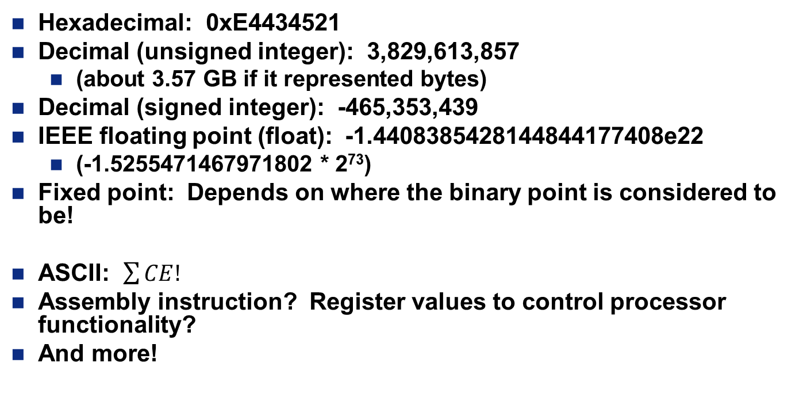
What does that data mean?
1110 0100 0100 0011 0100 0101 0010 0001
Hexadecimal: 0xE4434521
Decimal (unsigned integer): 3,829,613,857
(about 3.57 GB if it represented bytes)
Decimal (signed integer): -465,353,439
IEEE floating point (float): -1.4408385428144844177408e22
(-1.5255471467971802 * 2⁷³)
Fixed point: Depends on where the binary point is considered to be!
ASCII: $\sum{CE!}$
Assembly instruction? Register values to control processor functionality?
And more!
Notes:
32-bits give you single precision floating point (called float or single in most programming languages)

Slide 5
Number Systems Expanded Normal Form
Decimal numbers (Base 10: 0-9)
Unsigned Binary numbers (Base 2: 0-1)
Range: 0 to 10^{N}-1 = 0 to 9999 for N=4
5x10³+3x10²+7x10¹+4x10⁰
Range: 0 to 2^{N}-1 = 0 to 15 for N=4
1x2³+1x2²+0x2¹+1x2⁰ = 13₁₀

Slide 6
Number Systems Expanded Normal Form
Octal numbers (Base 8: 0-7)
Hex numbers (Base 16: 0-F)
1’s column
8’s column
64’s column
1024’s column
Range: 0 to 8^{N}-1 = 0 to 4095 for N=4
7014₈
= 7x8³+0x8²+1x8¹+4x8⁰ = 3596₁₀
1’s column
16’s column
256’s column
4096’s column
Range: 0 to 16^{N}-1 = 0 to 65535 for N=4
DE2A₁₆
= 13x16³+14x16²+2x16¹+10x16⁰ = 56,874₁₀

Slide 7
Hexadecimal Numbers
Hex Digit | Decimal Equivalent | Binary Equivalent | Octal Equivalent
0 | 0 | 0000 | 0
1 | 1 | 0001 | 1
2 | 2 | 0010 | 2
3 | 3 | 0011 | 3
4 | 4 | 0100 | 4
5 | 5 | 0101 | 5
6 | 6 | 0110 | 6
7 | 7 | 0111 | 7
8 | 8 | 1000 | 10
9 | 9 | 1001 | 11
A | 10 | 1010 | 12
B | 11 | 1011 | 13
C | 12 | 1100 | 14
D | 13 | 1101 | 15
E | 14 | 1110 | 16
F | 15 | 1111 | 17
Copyright © 2007 Elsevier

Slide 8
Number System Conversions
 | Convert To:
Convert From: | Binary | Octal | Hexadecimal | Decimal
Binary | X | Substitution | Substitution | Summation
Octal | Substitution | X | Substitution | Summation
Hexadecimal | Substitution | Substitution | X | Summation
Decimal | Division | Division | Division | X
Division: Divide a number of larger base by the lower base and assign the remainder as the LSB up to the MSB.
Summation: Use the positional numbering system to multiply the digit by the power of the position (A_{n}b^{n} + A_{n-1}b^{n-1} + … + A₁b¹+ A₀b⁰ = ).
Substitution: The Rule of Threes (for binary ⬄ octal) and the Rule of Fours (for binary ⬄ hexadecimal)

Slide 9
Exercise
Decimal | Binary | Hexadecimal
2,007
 | 11011b
 |  | 0xDEAD
0111 1101 0111b
0x7D7
27
0x1B
57,005
1101 1110 1010 1101b

Slide 10
Bits, Bytes, Nibbles…
Bits
Bytes & Nibbles
Bytes
Copyright © 2007 Elsevier

Slide 11
Unsigned Addition
Binary addition is like decimal additional
Need carry bits, may have an overflow
111.
0111
+0101
1100
Carry bits
0111
+0101
7
5
12
11.1.
1101
+0101
10010
Carry bits
1101
+0101
13
5
L
2
Overflow!
Carry bit

Slide 12
Carry/Overflow
Overflow – Overflow occurs when the answer is too big to fit in the available number of bit
The answer is not the correct sign (2’s Comp)
Carry – Whenever your answer takes more than a single bit, the extra bit is a carry.
What about Negative numbers?

Slide 13
Subtraction
We could use normal subtraction but that is not the most efficient way to do it.
What is another way to do subtraction?
0101
-0011
0010
5
3
2

Slide 14
Negative Numbers – Signed Magnitude
Most Significant Bit (MSB) is the sign, remaining numbers are the magnitude
0 represents positive and 1 represents negative
Benefit: Similar to how we do base10 negative #’s
Cons: Addition is broken, two representations of 0
Range: 2^{N-1}-1 to 2^{N-1}-1 or -7 to 7 for N=4
Sign bit, +
Sign bit, -
0111
= +7
1101
= -5
Magnitude: 7₁₀
Magnitude: 5₁₀

Slide 15
Negative Numbers – 2’s Complement
MSB has weight of –(2^{N-1}) (where N is number of bits of number)
0₁₀ is 0000…00b
Biggest number is 01111…11b = 2^{N-1}-1
Smallest number is 10000…00b = –(2^{N-1})
Benefit: Similar to how we do base10 negative #’s
Cons: None
Range: -8 to 7 for N=4
0111
1101
= -0x2³+1x2²+1x2¹+1x2⁰ = 7₁₀
= -1x2³+1x2²+0x2¹+1x2⁰ = -3₁₀

Slide 16
Negative Numbers – 2’s Complement
Sign is reversed for a 2s complement number by inverted all bits and adding 1 to the Least Significant Bit (LSB)
This is the quick way to writing negative 2’s Comp numbers
Example: Write -4 in 2’s Comp notation
+4 =
0100
Invert
1011
+1
1100
= -1x2³+1x2²+0x2¹+0x2⁰ = -4₁₀

Slide 17
Unsigned Binary
Why would we still use unsigned binary?
Benefit: Used by computers, can represent larger values.
Cons: Can’t represent negative numbers
Range: 0 to 2^{N}-1 or 0 to 15 for N=4

Slide 18


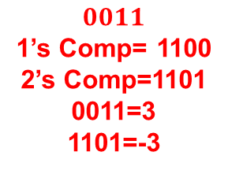
Subtraction
Can use 2s complement to add both positive and negative numbers
Lets redo 5-3 using 2’s compliment
$$5=0101$$
$$3=0011$$
1’s Comp= 1100
-3=1101
11.
0101
+1101
0110
$$0011$$
1’s Comp= 1100
2’s Comp=1101
0011=3
1101=-3
5
-3
-2

Slide 19
Signed Addition/Subtraction
Carry bits can indicate a problem, or not!
Carry never matters with sum or difference of positive and negative numbers
0111
+1001
+7
111.
0111
+1001
10000
-7
No problem, Discard this carry
0

Slide 20
Signed Addition/Subtraction
If two positive numbers or two negative numbers, overflow happens when MSB is opposite sign of addends
0011
+0110
+3
11..
0011
+0110
1001
+6
This overflow caused a problem
-7

Slide 21


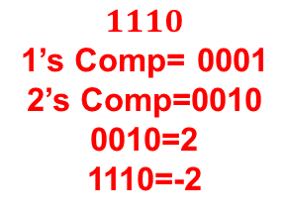
Practice
Add 5 and -7 utilizing 4-bit 2’s compliment
$$5=0101$$
$$7=0111$$
1’s Comp= 1000
-7=1001
1.
0101
+1001
1110
$$1110$$
1’s Comp= 0001
2’s Comp=0010
0010=2
1110=-2
+5
-7
-2

Slide 22

Practice
Add -6 and -7 utilizing 4-bit 2’s compliment
$$6=0110$$
1’s Comp= 1001
-6=1010
$$7=0111$$
1’s Comp= 1000
-7=1001
1010
+1001
0011
-6
-7
3
OVERFLOW!

Slide 23

23

